Slide 1
Research Intern at Times Network
Presentation by,
Asma Shaikh

Slide 2


















About Times Network
Times Network is the television division of Bennett, Coleman & Company Limited (BCCL) the parent company of India’s largest media conglomerate, the Times Group which owns and operates, inter alia, The Times of India, Economic Times and Mumbai Mirror, India’s leading print publications.
Hindi Music & Bollywood
English General News
English Business News
English Entertainment & Strategic Think Tank
Movie Channel Extensions & HD Variants
English News Extensions
Original Content – Digital
Originals – Factual Content
Short-form
& Rapid Content
Hindi
General News & Business News
English Movies
Discerning
Cinema
2004
2006
2009
2010
2013
2015
2016
2017
2018
2019
2020
2021
Times Network has consistently created reputed brands to cater to top of the pyramid consumers.
TIMES NETWORK - Informs, Entertains and Engages close to
142 Million Affluent Viewers in Urban India*
*Source : BARC | NCCS 2+ | All India Urban | July 22 to Oct’22 (Times Network SD+HD| Avg Monthly Reach (Mn)

Slide 3
Projects:
Qualitative Data Analysis
The method of consistently looking and composing the interview records, observation notes, or completely different non-textual materials that the investigator accumulates to increase the understanding of an event.
Despite being a mouthful, quantitative data analysis simply means analyzing data that is numbers-based – or data that can be easily “converted” into numbers without losing any meaning.
Quantitative Data Analysis

Slide 4
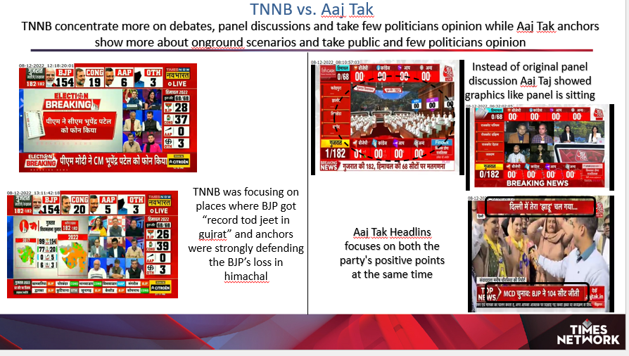
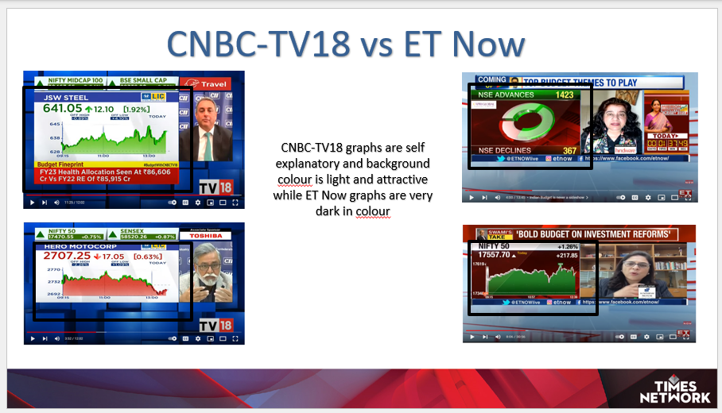
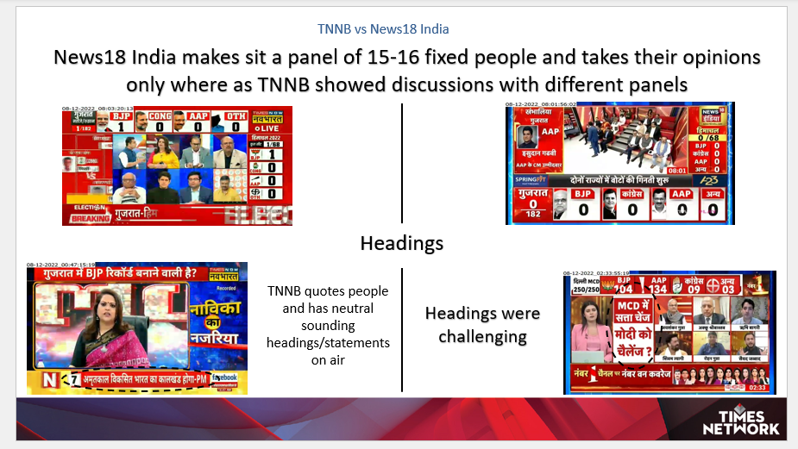

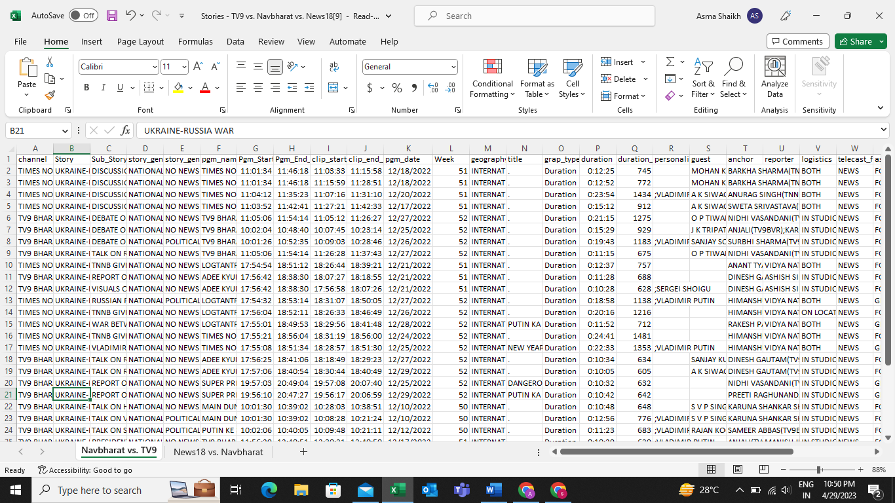
Gujarat Elections
2. Budget Day Analysis
3. War Coverage
Detailed data of December 2022 Russia-Ukrain war coverage of different channel, for different time slots was given
The Images of the prepared report after doing detailed research of the content asked
The study was focused on 2022 Gujarat Elections
This study was focused on the Budget Day (1st February 2022) on-air content of ET-Now and CNBC-TV18.
The Aim was to compare Times Now Navbharat (TNNB) Gujrat Elections coverage with competitions to understand the difference of Graphics, Speech, Headlines, Accuracy of the on-air content, etc
Qualitative Data Analysis

Slide 5
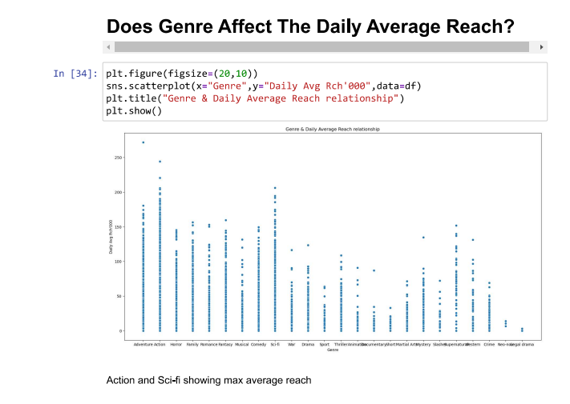
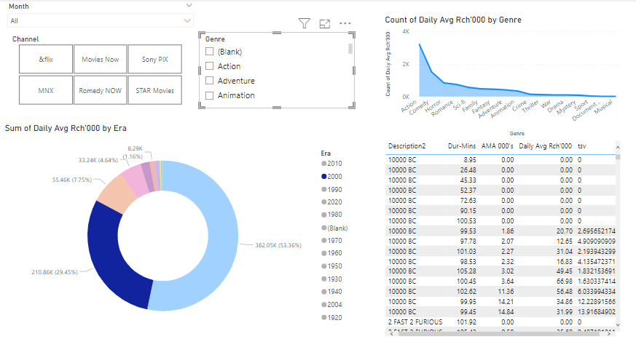
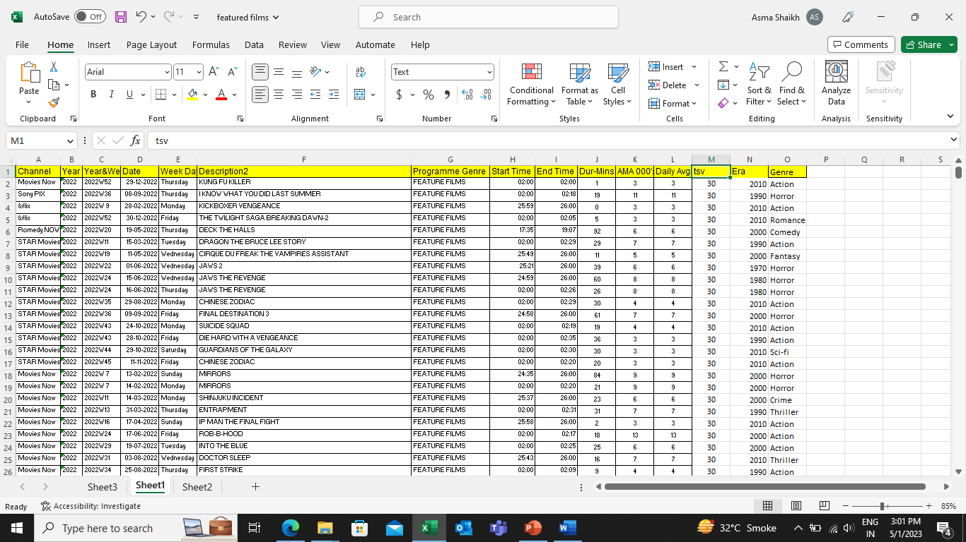
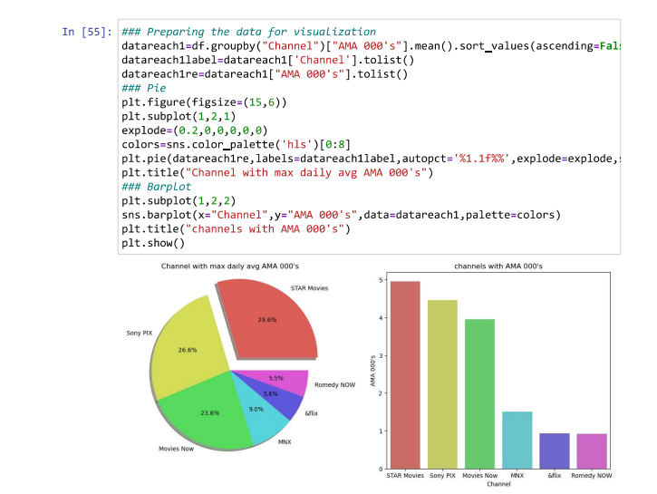
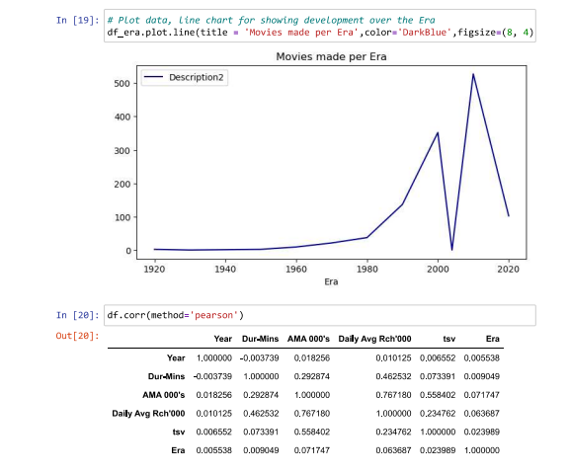
Detailed data was given
This analysis was aimed to compare our English Movie Channels with competition brands
Tool used for Analysis – Python
Dashboard building using Power BI
Quantitative Data Analysis

Slide 6
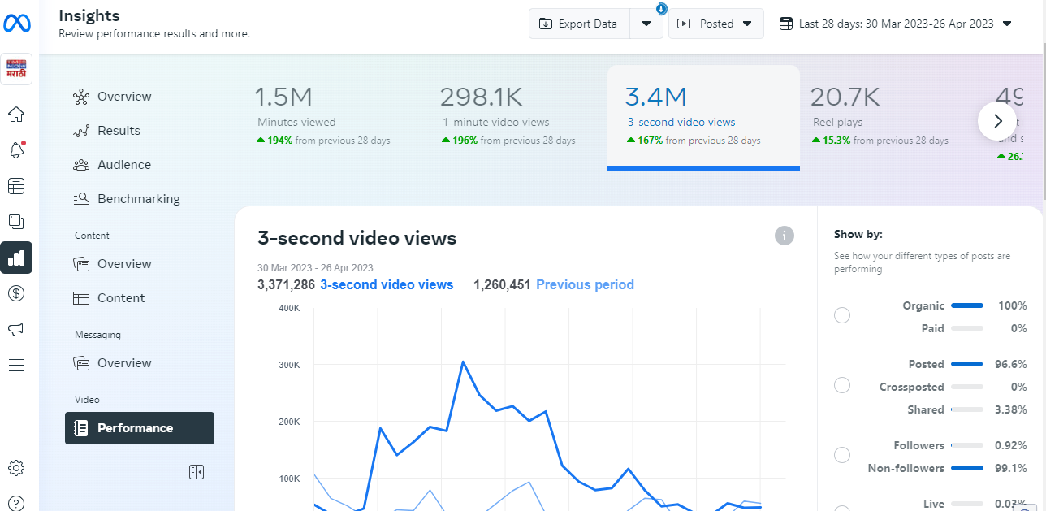
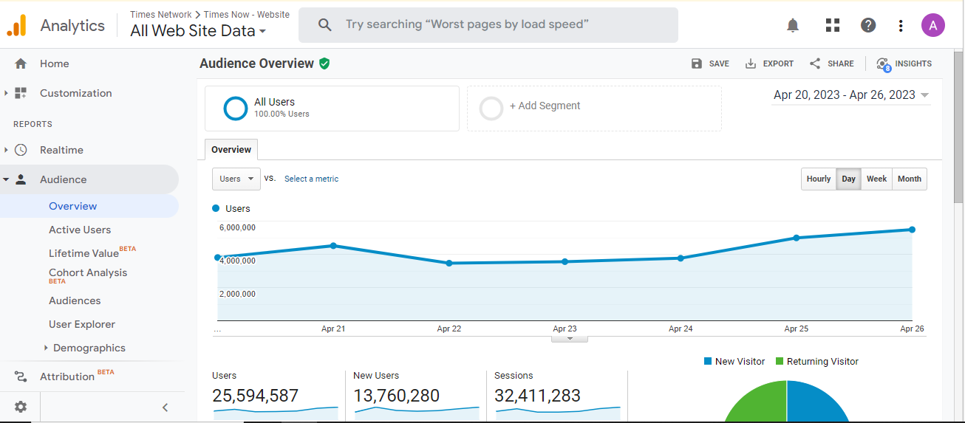
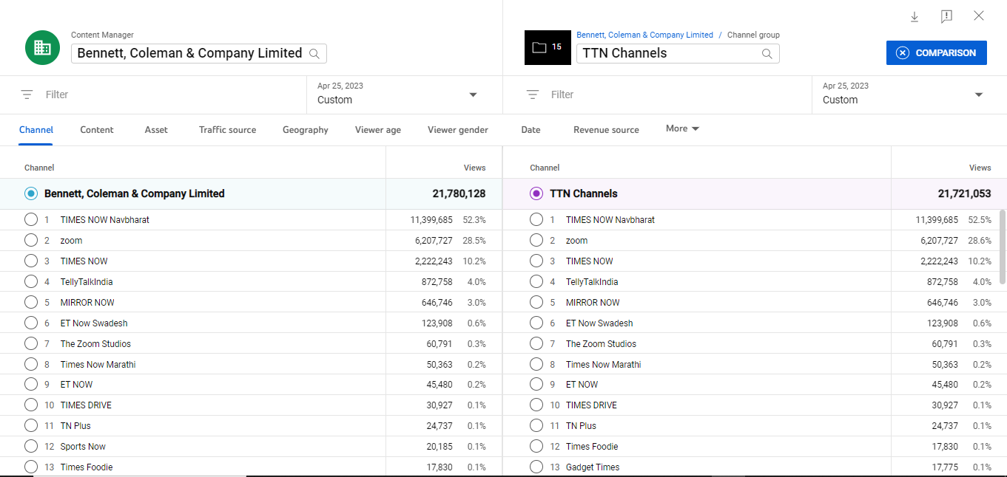
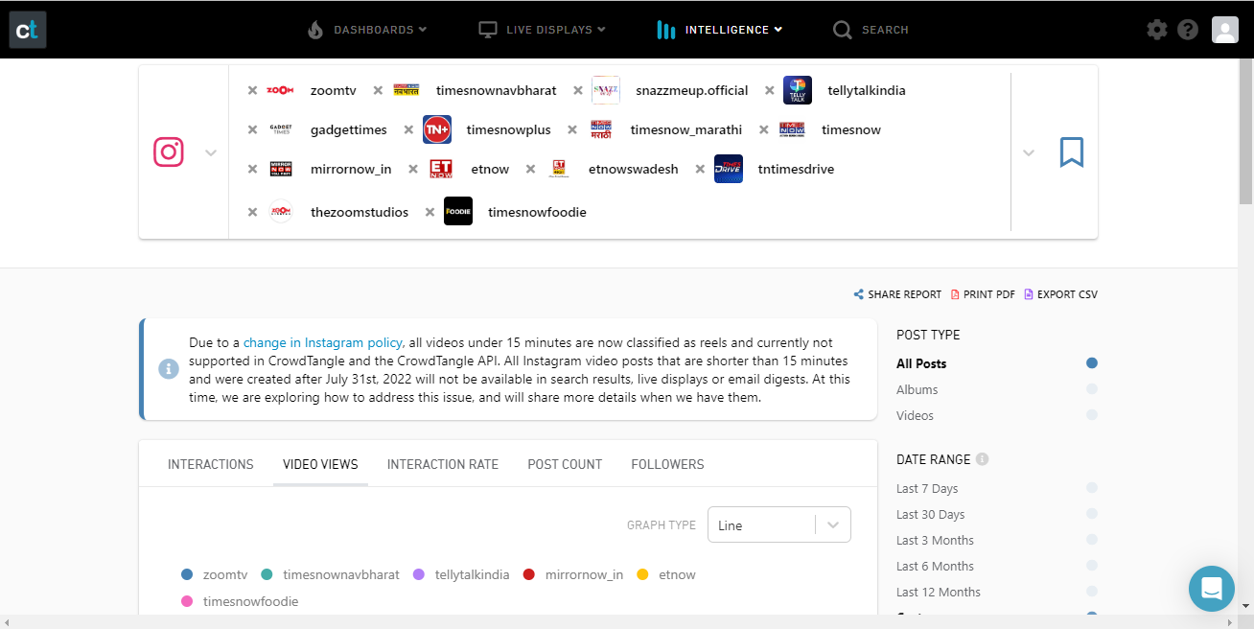
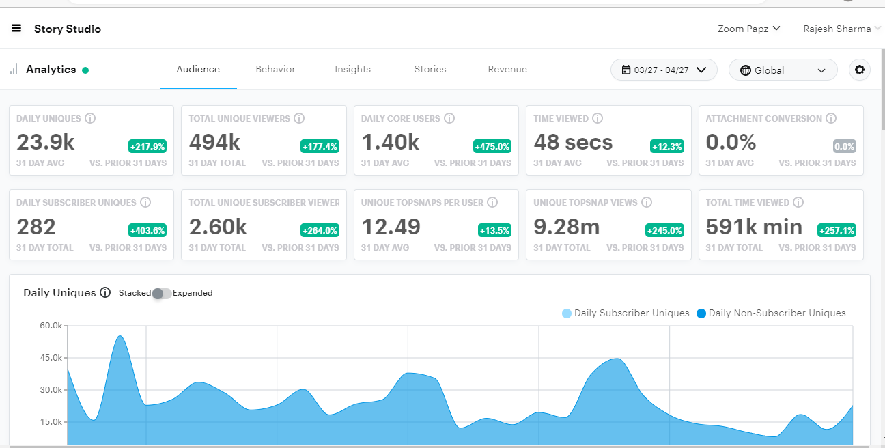
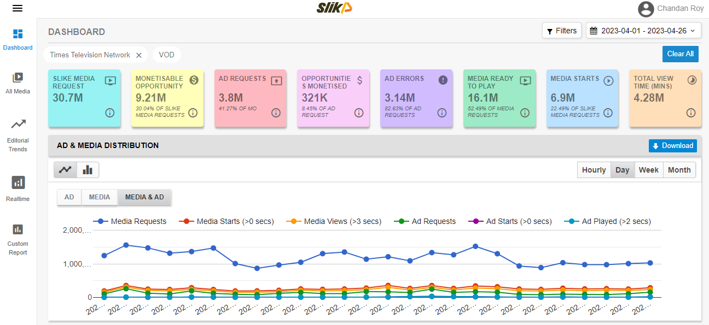
Slike
YouTube Analytics
Snapchat Analytics
Google Analytics
Creator Studio
CrowdTangle
To monitor daily performance of Times Network’s Youtube Channels Zoom, Times Now, TN Navbharat, Times Foodie, Times Drive, Telly Talk India, The Zoom Studios, MIRROR NOW, ET NOW, TN Plus, ET Now Swadesh, Snazz Me Up, Gadget Times, TN Marathi, TIMES NOW WORLD we use Youtube Analytics to make daily report which has information about daily views on each post of the Channel.
To monitor daily performance of Times Network’s Facebook Pages, Zoom, Times Now, TN Navbharat, The Foodie, Times Drive, Telly Talk, The Zoom Studios, Mirror Now, ET Now, TN+, ET Now Swadesh, Snazz Me Up, Gadget Times, TN Marathi I have use Creator Studio to make daily report which has information about daily views of the page
To monitor daily performance of Times Network’s Official Instagram pages, Zoom, Times Now, TN Navbharat, The Foodie, Times Drive, Telly Talk, The Zoom Studios, Mirror Now, ET Now, TN+, ET Now Swadesh, Snazz Me Up, Gadget Times, TN Marathi we use CrowdTangle to make daily report which has information about daily views on each post, Likes, Followers etc. of the page
To monitor daily performance and content operation across the brand of Times Network’s website and App. This gives performance of content, advertisement run in those properties, nature of traffic (organic or paid), missed opportunity of advertisement,
Table on the right shows daily level performance of video across brand of Times together for the April month, which says performance of last few days is stable after drop from initial level of the month
To monitor daily performance of Times Network’s Snapchat Channels, Zoom, Times Now, TN Navbharat, The Foodie, Times Drive, Telly Talk, The Zoom Studios, Mirror Now, ET Now, TN+, ET Now Swadesh, Snazz Me Up, Gadget Times, TN Marathi we use Snapchat Analytics to make daily report which has information about daily views on each post of the Channel
To monitor daily performance of Times Network’s website we use Google Analytics to make daily report which has information about New Users, Page Views, Content wise website performance etc.
Website and Social Media Handle Monitoring Tools

Slide 7
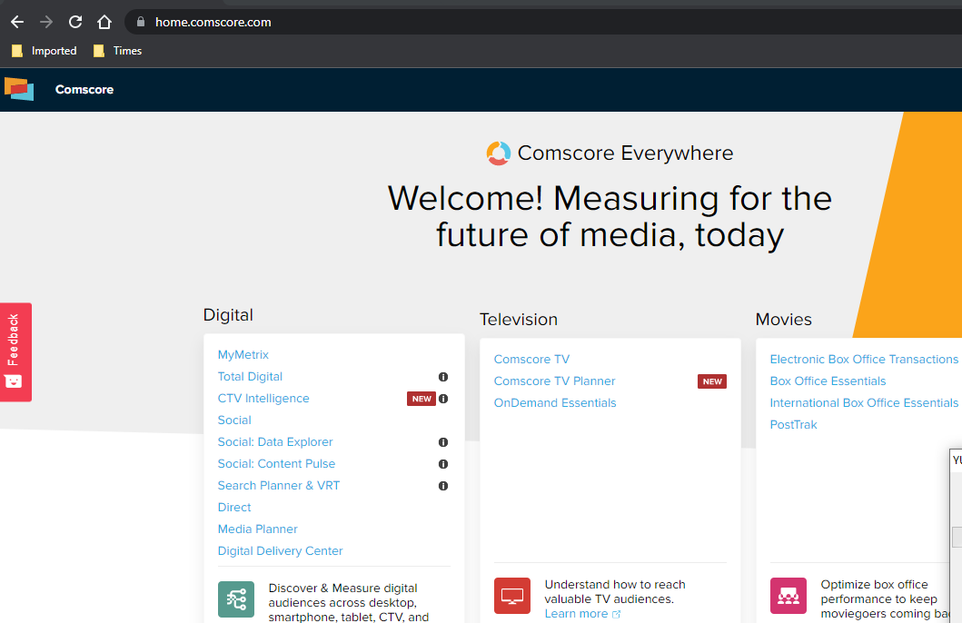
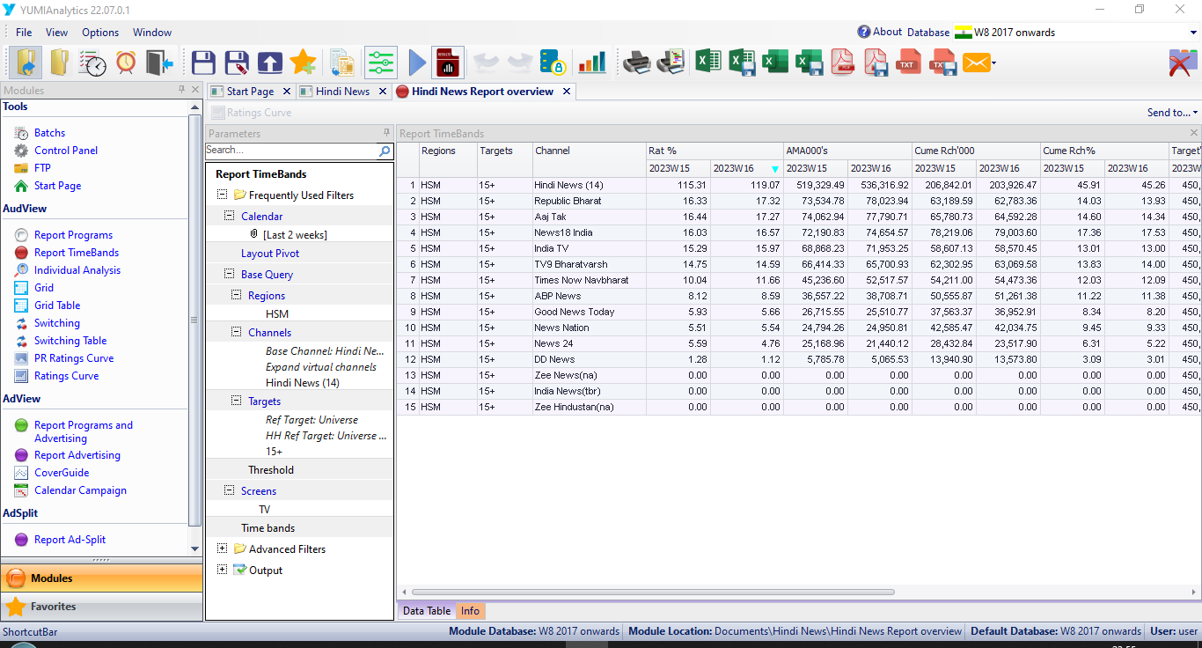
Other Tools…
comScore
YUMI (BARC)

Slide 8
Thank You

